Slide 1
SQL Programming
Joining Tables – Part 2

Slide 2
Module 09: Joining Tables Page A-1: Intro
In this module we’ll continue our discussion on joining tables.
Here’s what I expect you to ‘know’ and/or be able to do coming in to this lesson.
Join an arbitrary number of tables using the Cartesian product (aka cross join)
Anticipate the number of columns and the number of rows for any cross join
Relationships may be pre-defined in the database thru the use of foreign key – primary key associations
And if you think about it, the Cartesian product (aka cross join) joins tables regardless of any pre-defined associations.

Slide 3
Module 09: Joining Tables Page A-2: Intro
Joins come in a number of ‘flavors’ and we’re going to examine each of them in this module.
We’ll still rely on the WHERE clause to manage our joins, and in a future lesson we’ll learn a more modern technique for joining tables.
But I want to hold off introducing that newer technique until you’ve learned the fundamentals. Once you’ve mastered the underlying concepts, the newer technique can be learned in a matter of minutes.
One other reason for spending time on the older technique is this: as an apprentice SQL programmer, you’ll likely have to work on code that someone else developed. You’ll need to be able to work with the older style, as well as the newer style of SQL joins. So there’s just no getting around not learning the ‘old ways’.

Slide 4
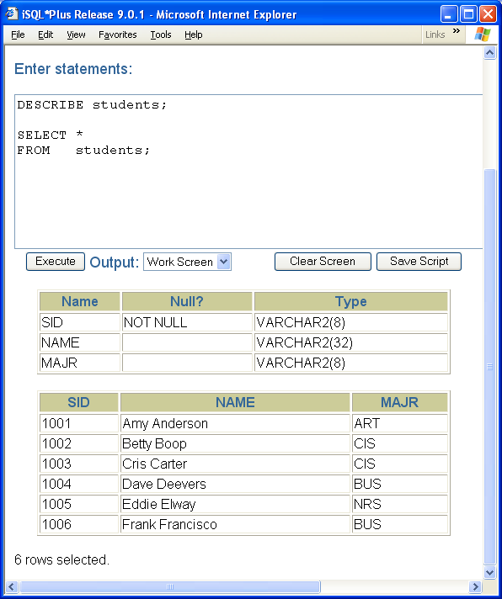
Module 09: Joining Tables Page A-3: Sample Data - students
Here are the tables of data that I’ll be using to highlight the concepts in this module.

Slide 5
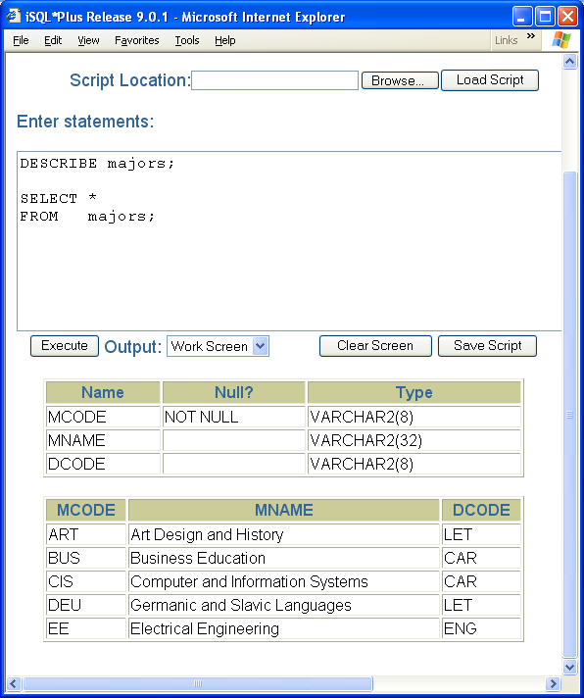
Module 09: Joining Tables Page A-4: Sample Data - majors
Here are the tables of data that I’ll be using to highlight the concepts in this module.

Slide 6
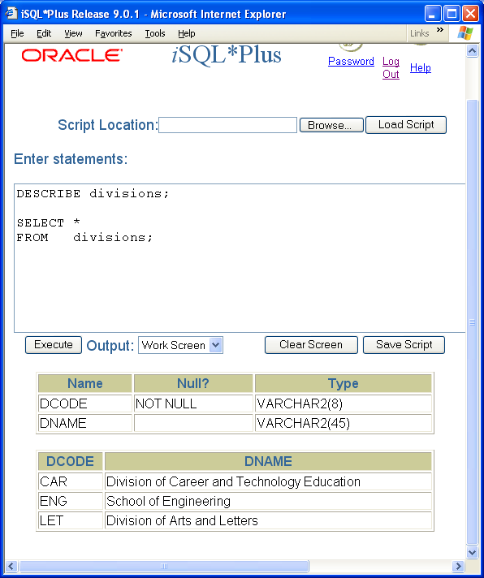
Module 09: Joining Tables Page A-5: Sample Data - divisions
Here are the tables of data that I’ll be using to highlight the concepts in this module.

Slide 7
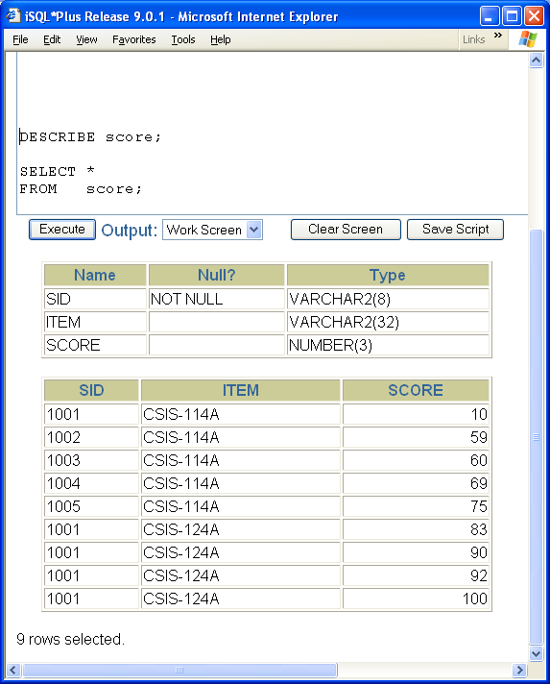
Module 09: Joining Tables Page A-6: Sample Data - score
Here are the tables of data that I’ll be using to highlight the concepts in this module.

Slide 8
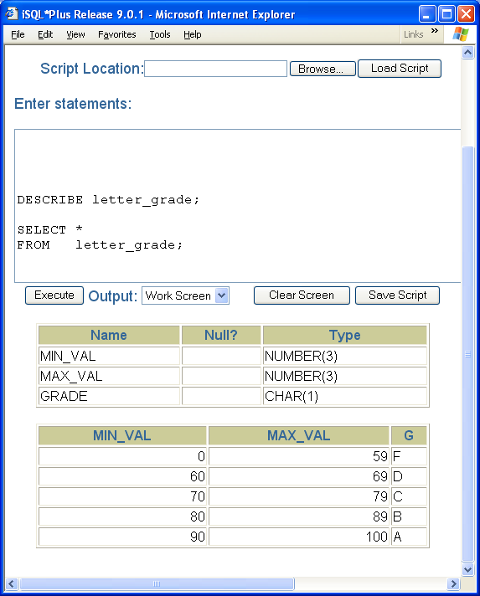
Module 09: Joining Tables Page A-7: Sample Data – letter_grade
Here are the tables of data that I’ll be using to highlight the concepts in this module.

Slide 9
Module 09: Joining Tables Page B-1: Joins
These are the joins that we’re going to cover:
Cross joins (B)
Equi-join (C)
Natural join (D)
Non-equi join (E)
Theta join (F)
Inner joins (G)
Outer joins (H)
Left outer join (I)
Right outer join (J)
Full outer join (K)

Slide 10
Module 09: Joining Tables Page B-2: Cross Joins
Cross joins are the theoretical underpinning of joins in the ‘relational algebra’. As long as we have a system that can give us cross joins, we can ‘derive’ all of the other kinds of joins.
So there you have it, something to use at a cocktail party to impress your mates.
As to when you might use a cross join for some practical application?
How about, any time that you want to combine every single row in one table with every other row in another table. But this rarely comes up, I mean, cross joins are a pretty rare occurrence.
Although I once did have occasion to use a cross join….

Slide 11
Module 09: Joining Tables Page B-3: Cross Joins
It was back in the day when I was building a new academic information system for one of the offices that I worked in.
We were essentially converting from a paper-based record keeping system to a computer based system.
Our goal was to capture as much of the data as possible in electronic format.
We were drawing information from three or four different sources for this one subsystem. Only one of the sources had a bona fide key value (social security number), the other sources used name information. And those name values weren’t in the same format. One source included a full middle name, in the format first name + middle name + last name, the other source was last name first, first initial, middle initial.

Slide 12
Module 09: Joining Tables Page B-4: Cross Joins
Each of these sources captured a different view of the total data set that we were trying to build. And we wanted to align each of the data sources with their correct partner records.
The cross join linked every possible combination and that was our starting point.
From there we whittled down the rows until we captured as much of the information as we could afford (this was rather time and resource intensive).
But this did allow us to go back, maybe 20 years in time, and eventually roll forward with 85% of the records intact.

Slide 13
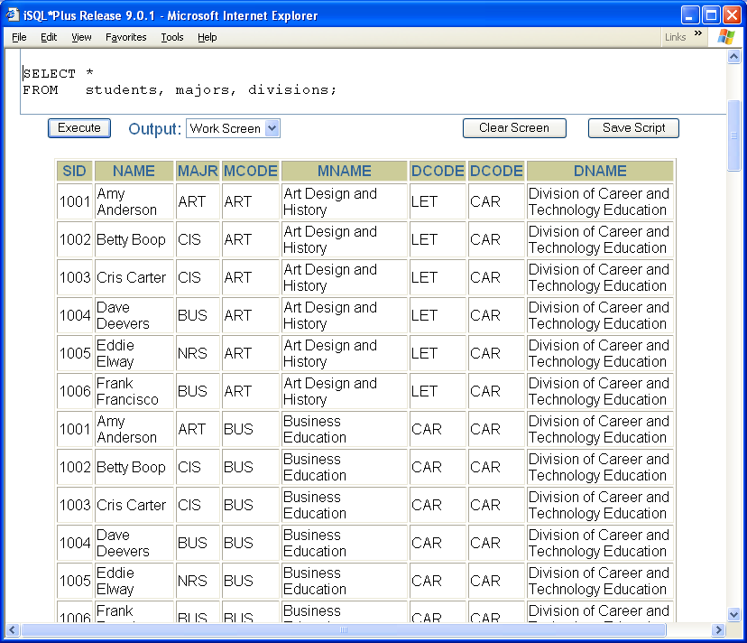
Module 09: Joining Tables Page B-5: Cross Joins
Cross joins are created simply by listing the table names in the FROM clause.
Syntax:
SELECT column-list
FROM table-list
Example:
SELECT *
FROM students, majors, divisions
The student table contains 6 rows, 3 columns.
The major table contains 5 rows, and 3 columns.
The divisions table contains 3 rows and 2 columns.
How many rows are there in the result table of the cross product?
How many columns are there in the result table of the cross product?

Slide 14
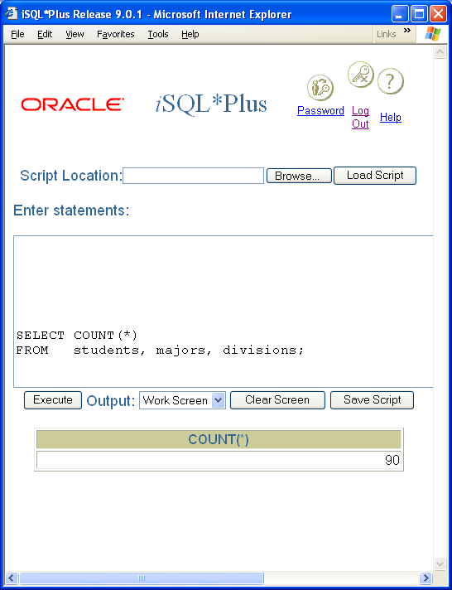
Module 09: Joining Tables Page B-6: Cross Joins
There are 90 rows and 8 columns.

Slide 15
Module 09: Joining Tables Page C-1: Equi-Joins
An equi-join is a join that is based on some equality condition.
So, if you use an equal sign in the predicate expression of the WHERE clause, you’ve got yourself an equi-join.
My guess is that equi-joins probably constitute over 90% of the joins that you’ll ever write.
Syntax:
SELECT column-list
FROM table-list
WHERE column-a = column-b

Slide 16
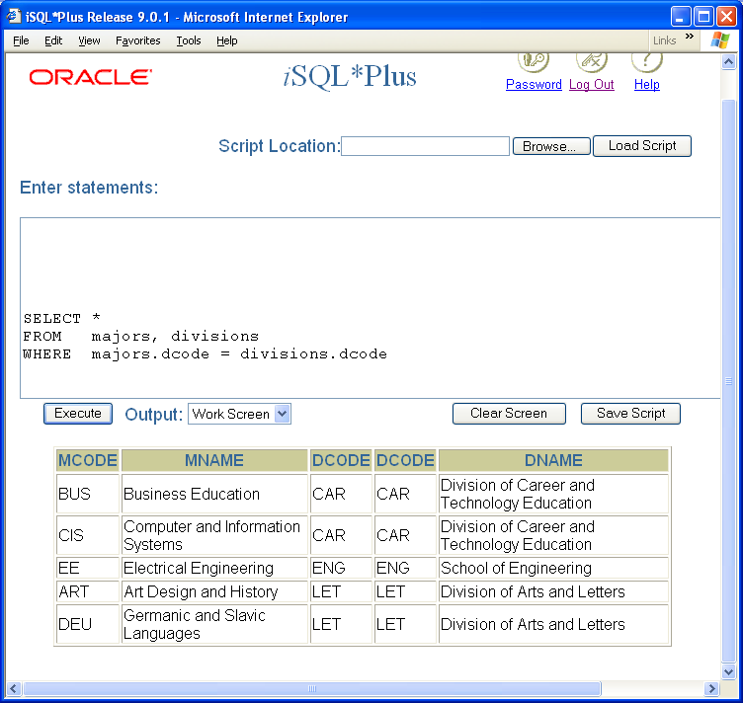
Module 09: Joining Tables Page C-2: Equi-Joins
Example:
SELECT *
FROM majors, divisions
WHERE majors.dcode = divisions.dcode
This equi-join is formed, conceptually, by doing the cross join on majors and divisions, and then keeping only those rows where the predicate (condition) majors.dcode = divisions.dcode is TRUE.
Let’s break that down.

Slide 17
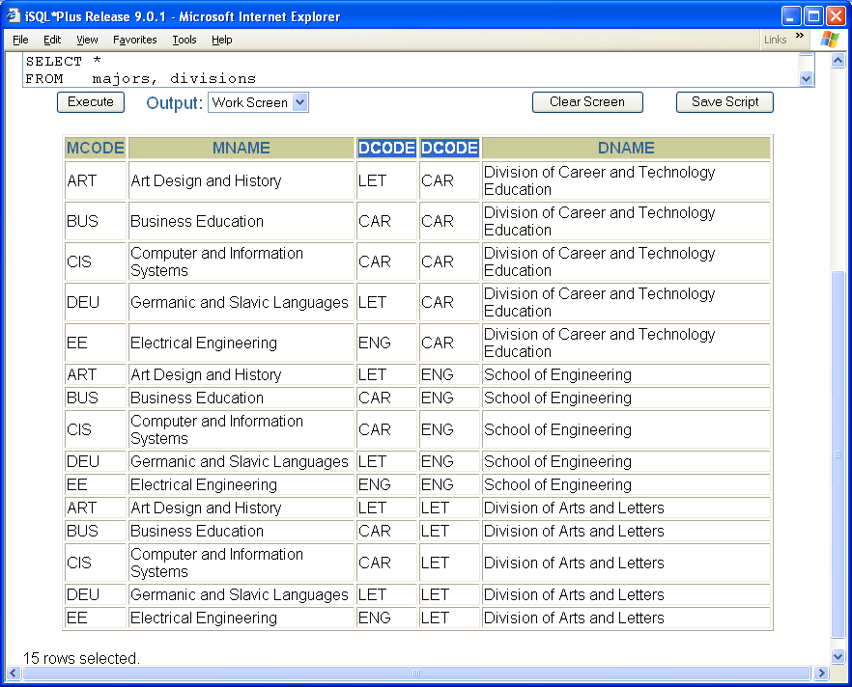
Module 09: Joining Tables Page C-3: Equi-Joins
Here is the cross join of the majors and divisions tables.
These fifteen rows represent the first working table that is created by the FROM clause.
When we add the equi-join, that is when we apply the predicate expression in the where clause, only the rows in this table that share the same value in the two dcode columns will be passed forward to the result table.
Examine the two dcode columns and see if you can tell which rows will be carried forward to the result table.

Slide 18
Module 09: Joining Tables Page C-4: Equi-Joins
When the WHERE clause kicks in, after the FROM clause, we’re left with only those rows that satisfy the condition:
majors.dcode = divisions.dcode

Slide 19
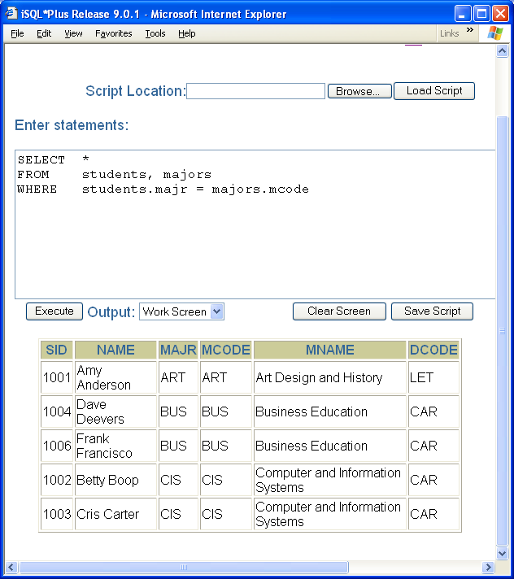
Module 09: Joining Tables Page C-5: Equi-Joins
Let’s consider another example that equi-joins the STUDENTS and MAJORS table.
SELECT *
FROM students, majors
WHERE students.majr = majors.mcode

Slide 20
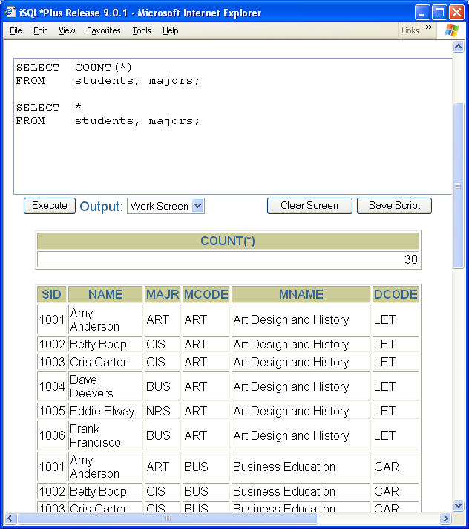
Module 09: Joining Tables Page C-6: Equi-Joins
Conceptually, the first working table is generated by the FROM clause when it creates the cross join of students and majors.
The cross join generates a working table with 30 rows (6 * 5).

Slide 21
Module 09: Joining Tables Page C-7: Equi-Joins
Then the WHERE clause is applied to this working table to generate yet another working table, of only those rows that satisfy the condition:
students.majr = majors.mcode

Slide 22
Module 09: Joining Tables Page C-8: Equi-Joins
Why are there only 5 rows in this result table, when the STUDENTS table contains 6 rows, and the majors table contains 5 rows?
Can we come up with some rule that will help us anticipate the number of rows that will be created in an equi-join?

Slide 23
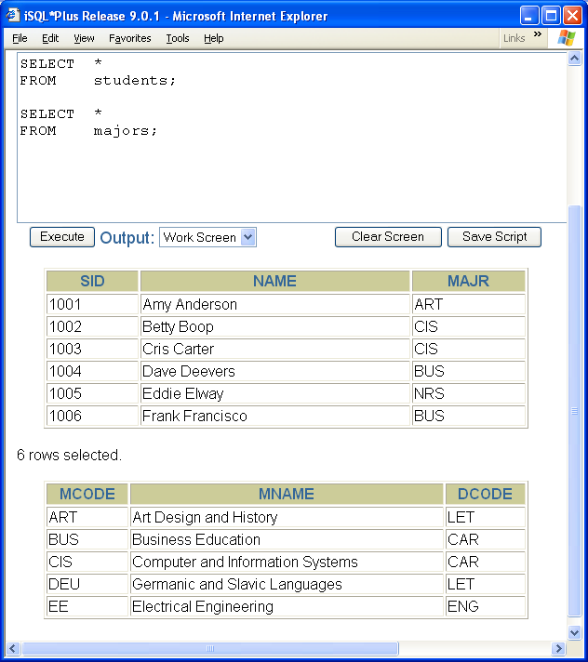
Module 09: Joining Tables Page C-9: Equi-Joins
As a rule of thumb, in an equi-join we wouldn’t normally expect to see more rows in the result table than the maximum number of rows in the largest table.

Slide 24
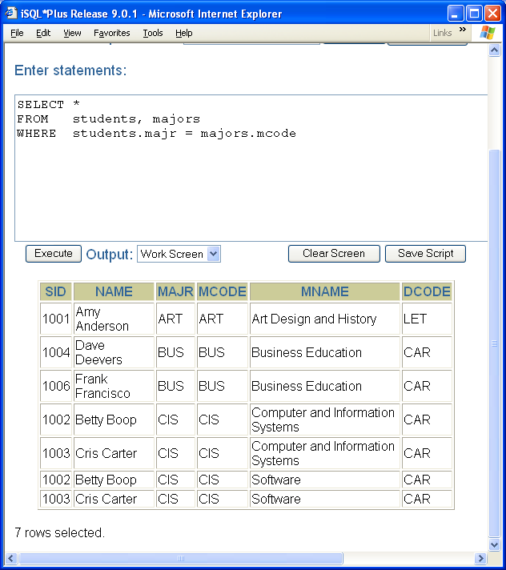
Module 09: Joining Tables Page C-10: Equi-Joins
But this presumes that we’re joining our tables on foreign-key to primary-key associations. If that’s not the case, then we really can’t predict the number of rows.
Let’s say I’ve added another row to the majors table, that in essence duplicate the key. In this example the rows in students link with rows from majors, but notice that there are two rows in the MAJORS table which share the same value that the equi-join is based on.
CIS – Comp and Info Systems
CIS – Software
In this example, after an equi-join, we have more rows in the result table than any single table. This is unusual and occurs only because we do not have unique keys in the tables.
But I digress. Let’s return to the original question.

Slide 25
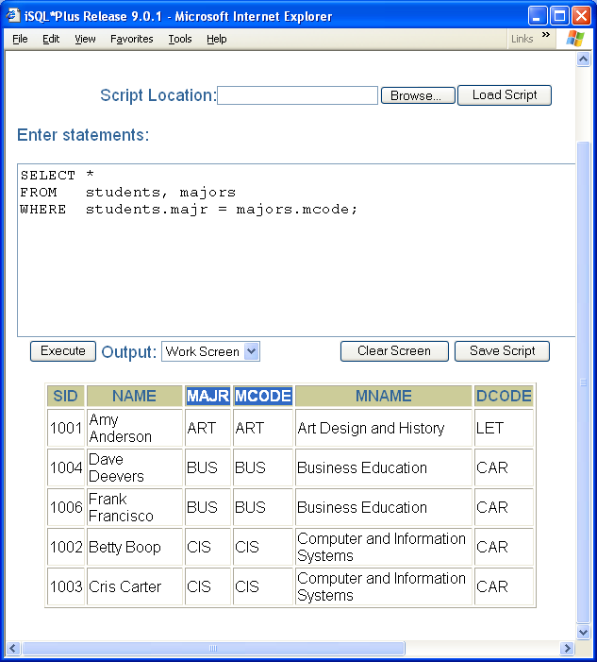
Module 09: Joining Tables Page C-11: Equi-Joins
Why are there only 5 rows in this result table, when the STUDENTS table contains 6 rows, and the majors table contains 5 rows?
There are only five rows in the result table because only five rows in the students table matched the condition that was specified in the predicate expression.

Slide 26
Module 09: Joining Tables Page C-12: Equi-Joins
The record for Eddy Elway shows this student has a major code=NRS.
But if you’ll notice, there is no NRS major code in the MAJORS table.
And, since there’s nothing for Eddy’s record to link up with in the majors table, this row doesn’t get carried forward to the result table.

Slide 27
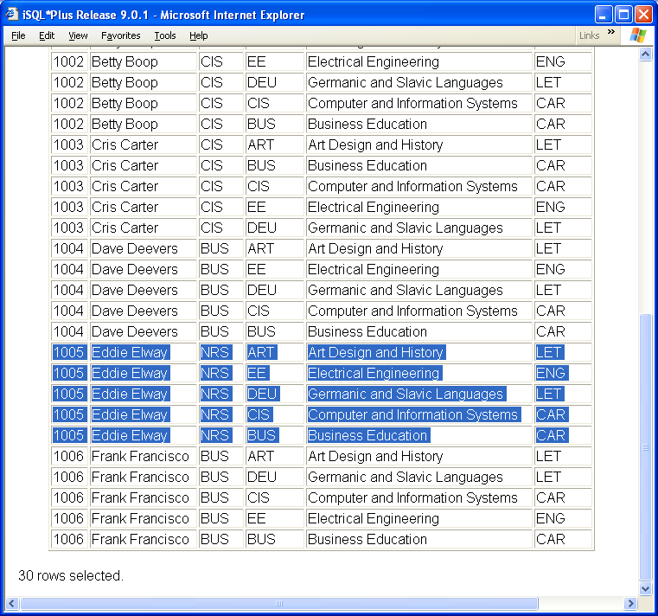
Module 09: Joining Tables Page C-13: Equi-Joins
Here is the section of the cross join table with Eddy’s records.
And since there was no NRS record in the majors table, there were no NRS entries to combine with Eddy’s record as part of the cross join, hence no records to satisfy the WHERE clause condition.

Slide 28
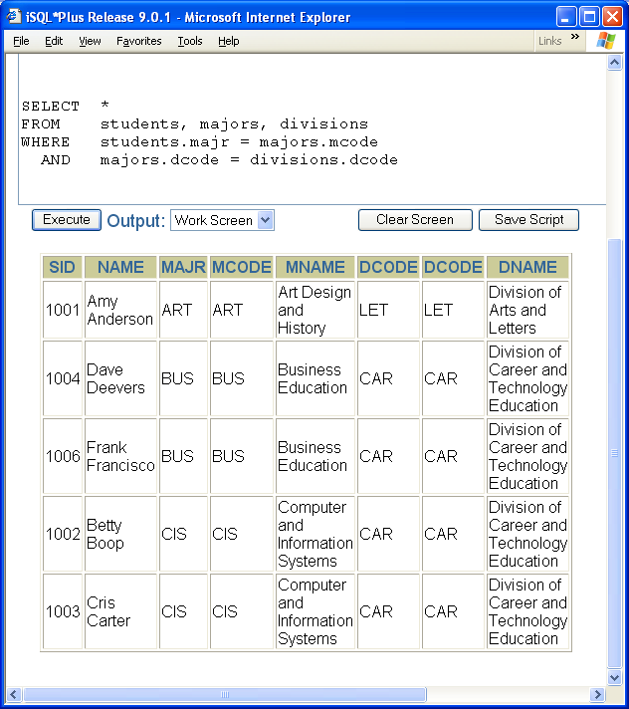
Module 09: Joining Tables Page C-14: Equi-Joins
Let’s look at an equi-join that involves 3 tables.
In order to equi-join two tables, there must be one predicate expression that links the two tables. For example
table1_column = table2_column
In order to equi-join three tables, there must be two predicate conditions, of the form
table1_column = table2_columna
AND table2_columnb = table3_column
The FROM clause creates the first working table based on the cross product of all three tables.
The WHERE clause carries forward only those rows that meet both criteria (AND).

Slide 29
Module 09: Joining Tables Page D-1: Natural Joins
A natural join is an equi-join that eliminates duplicate, or redundant, columns.
Each pair of tables that is joined in an equi-join shares a common column. When the tables are joined, say with with a SELECT *, there are two identical columns running down the length of the table.
In this example, MAJR and MCODE share the same values throughout the result table.
A natural join eliminates one of these redundant columns from the result table.

Slide 30
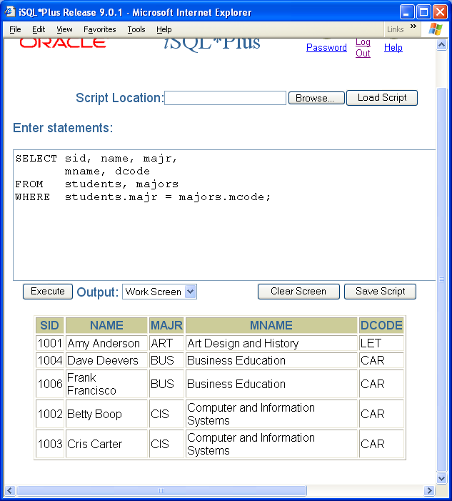
Module 09: Joining Tables Page D-2: Natural Joins
And the only way to do that, with the join technique we’re using, is to list each of the columns in the SELECT clause, being careful to eliminate one of the redundant columns.
Which column you choose to eliminate is immaterial, really, just so long as there are no redundant columns.
SELECT sid, name, majr,
mname, dcode
FROM students, majors
WHERE students.majr = majors.mcode;
SELECT sid, name,
mcode, mname, dcode
FROM students, majors
WHERE students.majr = majors.mcode;

Slide 31
Module 09: Joining Tables Page E-1: Non-Equi Joins
Now here’s a really tricky concept to learn, so pay close attention.
A non-equi join is a join that does NOT use the equality condition!
A non-equi join is a join that uses some comparison operator, other than equality, as the basis for the join.
Yep! That’s why we computing professional get paid the big bucks, we can deal with these really complicated terms ☺

Slide 32
Module 09: Joining Tables Page E-2: Non-Equi Joins
What comparison operators come to mind?

Slide 33
Module 09: Joining Tables Page E-3: Non-Equi Joins
What comparison operators come to mind?
=
<>
<
>
<=
>=

Slide 34
Module 09: Joining Tables Page E-4: Non-Equi Joins
What comparison operators come to mind?
=
<>
<
>
<=
>=
Are there any other comparison operators?

Slide 35
Module 09: Joining Tables Page E-5: Non-Equi Joins
What comparison operators come to mind?
=
<>
<
>
<=
>=
Are there any other comparison operators?
BETWEEN
LIKE
IS NULL
…

Slide 36
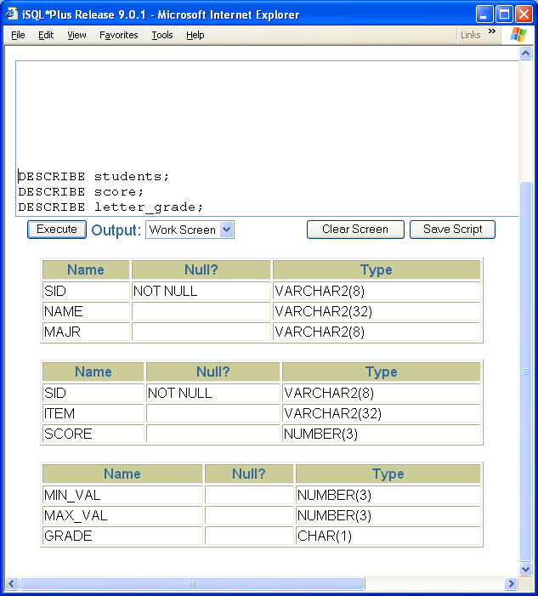
Module 09: Joining Tables Page E-6: Non-Equi Joins
In my experience, the most common non-equi join is based on the BETWEEN operator.
This allows the programmer to join rows based on a value that is included within some range of values.
Let’s consider an example that uses these three tables.

Slide 37
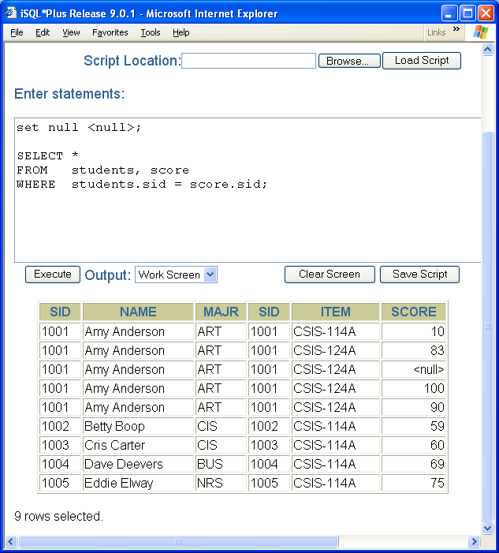
Module 09: Joining Tables Page E-7: Non-Equi Joins
We’ll equi-join students with score.

Slide 38
Module 09: Joining Tables Page E-8: Non-Equi Joins
But what we’d like to see, in addition to the student’s score, is the letter grade that’s associated with that score.

Slide 39
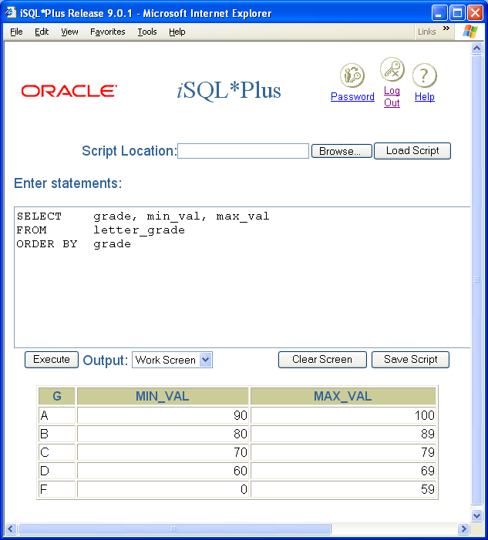
Module 09: Joining Tables Page E-9: Non-Equi Joins
The score table looks like this.
So, let’s use a non-equi join to join the scores table with the letter-grade table.

Slide 40
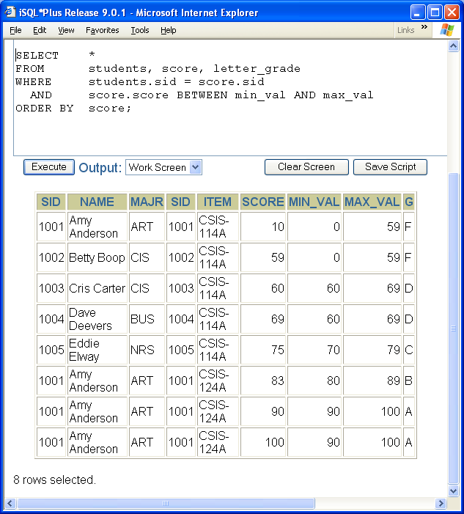
Module 09: Joining Tables Page E-10: Non-Equi Joins
This statement joins three tables, the first predicate expression equi-joins one pair of tables, the other pair of tables is joined with a non-equi (BETWEEN) predicate.

Slide 41
Module 09: Joining Tables Page E-11: Non-Equi Joins
Another common application for the non-equi join using the BETWEEN verb is with time ranges.
And we’ll leave that for the student to explore in the discussion forums. Come up with an application that uses a range of time values to set/establish some value.

Slide 42
Module 09: Joining Tables Page F-1: Theta Joins
E.F. Codd, one of the original researchers in the field of relational database theory, used the term theta operators to signify what we know as comparison operators (also sometimes referred to as the BIG 6 relational operators).
Theta operators include:
=
<>
<
>
<=
>=
And a theta-join is a join that is constructed using any of these theta operators.

Slide 43
Module 09: Joining Tables Page G-1: Inner Joins
An inner join is bound by a search expression, and disregards any rows where the search condition is not met.
That’s quite a mouthful. But I think once we explain outer joins, you’ll better understand inner joins.

Slide 44
Module 09: Joining Tables Page H-1: Outer Joins
An outer join is a special form of the join that insures that rows from either one, or both, tables are presented in the final result table.
I think of an outer join as anchoring the join on one of the tables, and making sure that every row in that table is represented in the joined result table.
Recall the example that we discussed earlier regarding Eddy Elway’s record. Eddy is a nursing major (NRS) but the majors table does not have an entry for the NRS major, and Eddy’s record did not appear in the joined result table.
The relevant information is displayed on the following slide.

Slide 45
Module 09: Joining Tables Page H-2: Outer Joins

Slide 46
Module 09: Joining Tables Page H-3: Outer Joins
Using the outer join technique we can insure that Eddy’s record doesn’t drop off the face of the planet, as this join might suggest.

Slide 47
Module 09: Joining Tables Page I-1: Left Outer Joins
A left outer join insures that all of the rows in the table on the left-hand side of the predicate expression are included.
The following example is based on the Oracle product, and is NOT representative of the standard.
Why did Oracle diverge from the standard and do something as ass-backwards as this? Actually they provided this feature to their user community long before the standard adopted outer joins. This is the price you pay for being at the forefront of technology. Sometimes newer, better techniques are adopted and you’re obliged to maintain past-practices so as to remain ‘backwards compatible’

Slide 48
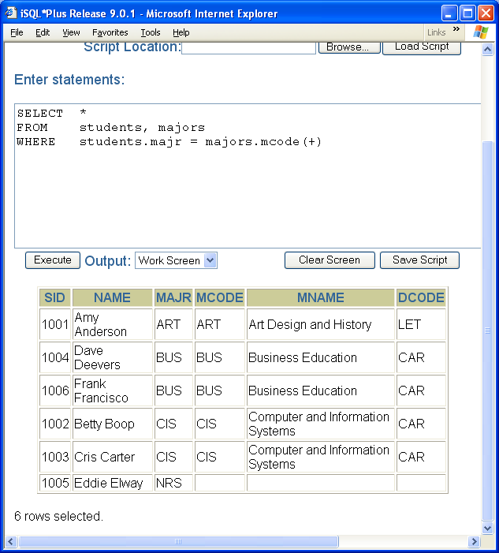
Module 09: Joining Tables Page I-2: Left Outer Joins
In the older technique, the way to perform a left-outer join was to include a plus sign next to the column on the right-hand side of the predicate expression.
In my way of thinking, this suggests that the right-hand side of the equation needs to contribute a value so that the left-hand side has something to link up with, and be included in the result table.
This query answers the question: prepare a roster of all student showing their major name. If students don’t have a major (or the major is invalid, leave the major name blank.

Slide 49
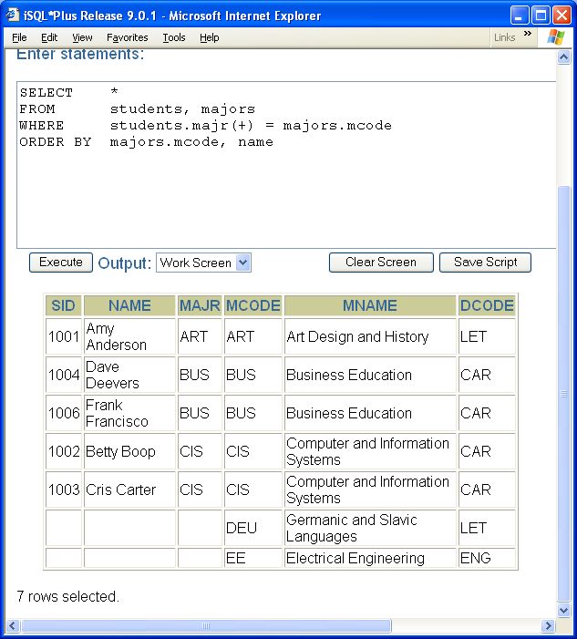
Module 09: Joining Tables Page J-1: Right Outer Joins
A right outer join insures that all of the rows in the table on the right-hand side of the predicate expression are included.
This right outer join might be used to answer the question, prepare a report showing all majors and the students enrolled in each.

Slide 50
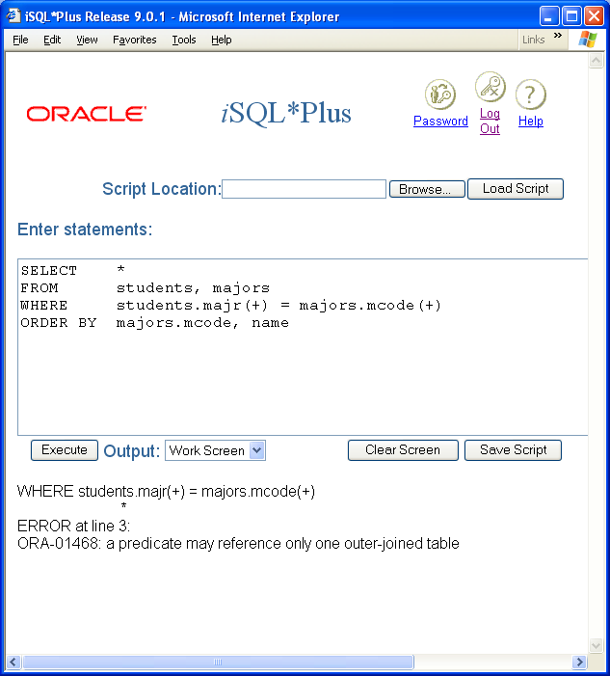
Module 09: Joining Tables Page K-1: Full Outer Joins
A full outer join insures that all of the rows in each of the tables are represented in the result table.
One would think that a full outer join, in the old style, could have been accomplished with something like this:
SELECT *
FROM students, majors
WHERE students.majr(+) = majors.mcode(+)
ORDER BY majors.mcode, name
But the Oracle rdbms didn’t support this feature.

Slide 51
Module 09: Joining Tables Page G-1: Inner Joins - revisited
So let’s revisit our description of inner joins, and see if they make any more sense, now that we’ve defined outer joins.
An inner join is bound by a search expression, and disregards any rows where the search condition is not met.

Slide 52
Module 09: Joining Tables Page T-1: Terminology
Cartesian product, cross product, cross join
Equi-join
Non equi-join
Theta join
Natural join
Inner join
Outer join
Left outer join
Right outer join
Full outer join

Slide 53
Module 09: Joining Tables Page Z-1: End Notes
Please drop me an email if you noticed any errors in this module. I’d also appreciate reading your comments, criticisms, and or suggestions as to how this module could be improved.
Were there any gaps in the information that was presented (ie. ‘leaps of faith’)?
Was any section unclear?
Did I happen to do a good job? ☺
Thanks,
bil

Slide 54
That’s All

